Slide 1
Break Even Analysis
Decision Modeling

Slide 2
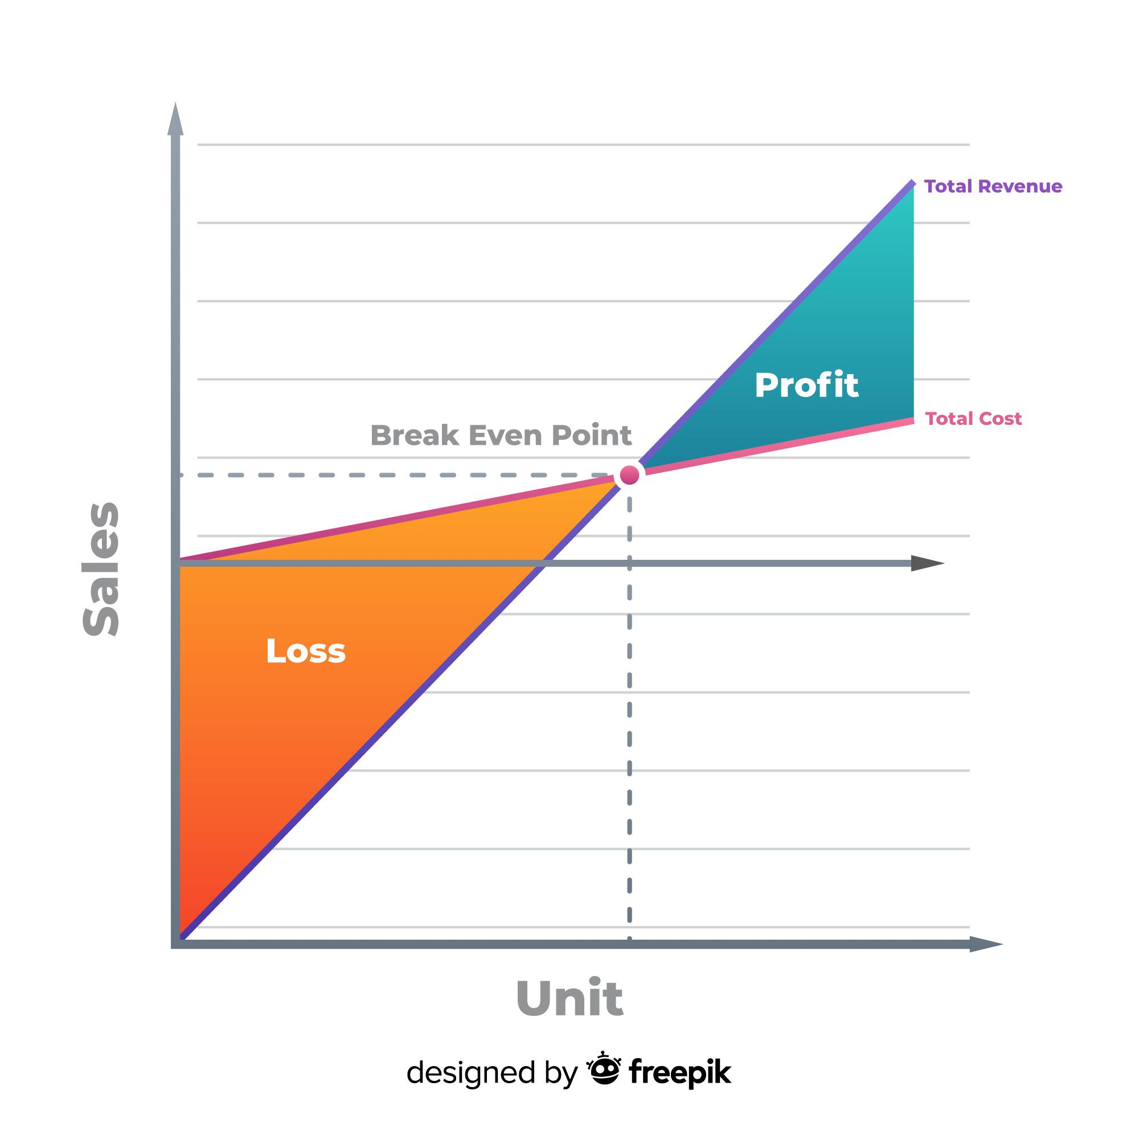
What is Break-even?
Primarily, any venture begun by a firm requires certain capital costs.
It is expected that the business recovers this initial capital through earnings over a period of time.
The position of no profit - no loss is termed as Break-Even for a venture.

Slide 3
Mathematical Modeling
The process of transformation business problem into a system using mathematical concepts, equations and notations is termed mathematical modeling. The Mathematical modeling is the core aspect of business analytics which enable to find optimum solutions or decisions
Total cost = Fixed cost (Development cost) + Variable cost (user costs)
Variable cost = per user cost x number of users
🡺 Total cost = fixed cost + per user cost x number of users
Mathematical model:
TC = Total Cost
F = Fixed cost
V = Variable unit cost
Q = Quantity produced

Slide 4
Make or Buy Decision Modeling - Manufacturing Example
The business can produce either manufacture product internally or buy from the market.
Manufacturing has fixed cost $50,000 of setting up manufacturing facility and manufacturing cost per unit of $125.
Buying from Market (Outsourcing) has no fixed cost and cost per unit is $175.
Decision is to choose more economic model based on volume of production.

Slide 5
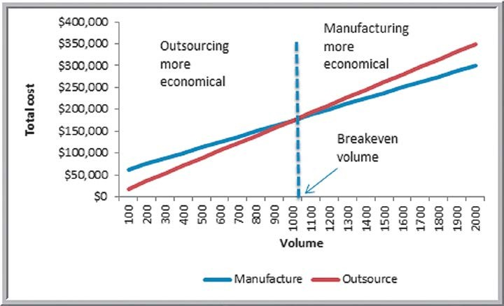
Break Even Decision Model
TC(manufacturing) = $50,000 + $125*Q TC(outsourcing) = $175*Q
Breakeven Point:
Q where TC(manufacturing) = TC(outsourcing)
$50,000 + $125 × Q = $175 × Q
$50,000 = 50 × Q
Q = 1,000
General Formula
F + VQ = CQ
Q = F/(C - V)
Make or Buy Decision

Slide 6
Decision Modeling
Software Purchase or In-House?
The business decision needs to be made to make or buy a software product.
Software development project costs $200,000 and maintenance of the software infrastructure costs $30 per user per annum.
Buying a SAAS product directly from a software vendor. This has no development or upfront costs, and the software vendor charges $250 per user per annum.
Decision is to choose more economic model based on the number of users.
Assume that development cost of $200k is required to maintain and add new feature every year.

Slide 7
Break Even Decision Model
Total Cost of Development = $200,000 + $30 x Users
Total Cost of SAAS software = $250 x Users
Breakeven Point:
Can get break even point by equating above equations
$200,000 + $30 x Users = $250 x Users
220xusers = 200,000 🡺 about 909 users.
This means at 909 users both costs are same. So, if number of users are more than 909, then we develop software otherwise buying SAAS software is better.
General Formula
F + VQ = CQ
Q = F/(C - V)

